Slide 1




Topological Quantum Compiling
with Reinforcement Learning
Yuanhang Zhang
Nov 16, 2021

Slide 2
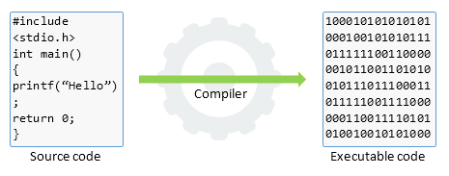
Classical compiling
High-level language
C++, java, python, …
For humans
Preprocessing
Optimization
Code generation
Low-level language
Assembly, machine language
For computers
Compiler

Slide 3
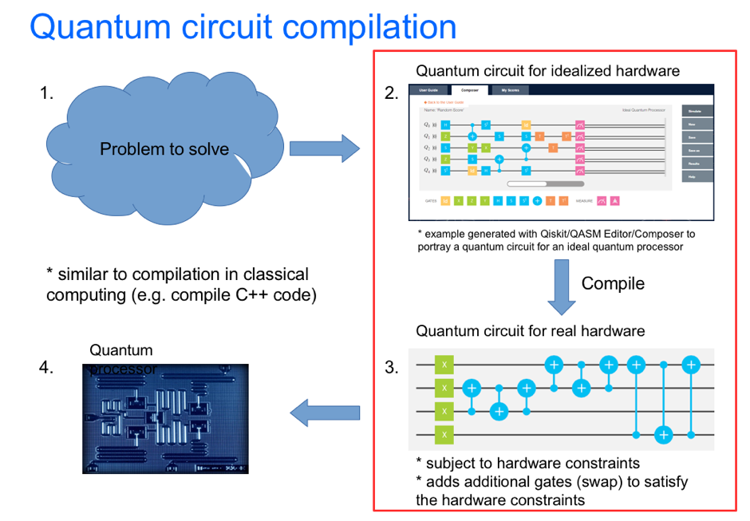
Quantum compiling
?
Hardware-compatible elementary gates
For quantum computers
Quantum algorithm
For humans
Quantum
Compiler

Slide 4
Quantum compiling
Intermediate code optimizer
Target
code generator
C
C++
Java
Python
Front
end
Non-optimized intermediate code
Optimized intermediate code
Machine code
High-level quantum language
Non-optimized quantum circuit
Optimized quantum circuit
Elementary gate operations
Stage 2
Our focus
Stage 1
Quantum Programming
Quantum Compiling

Slide 5
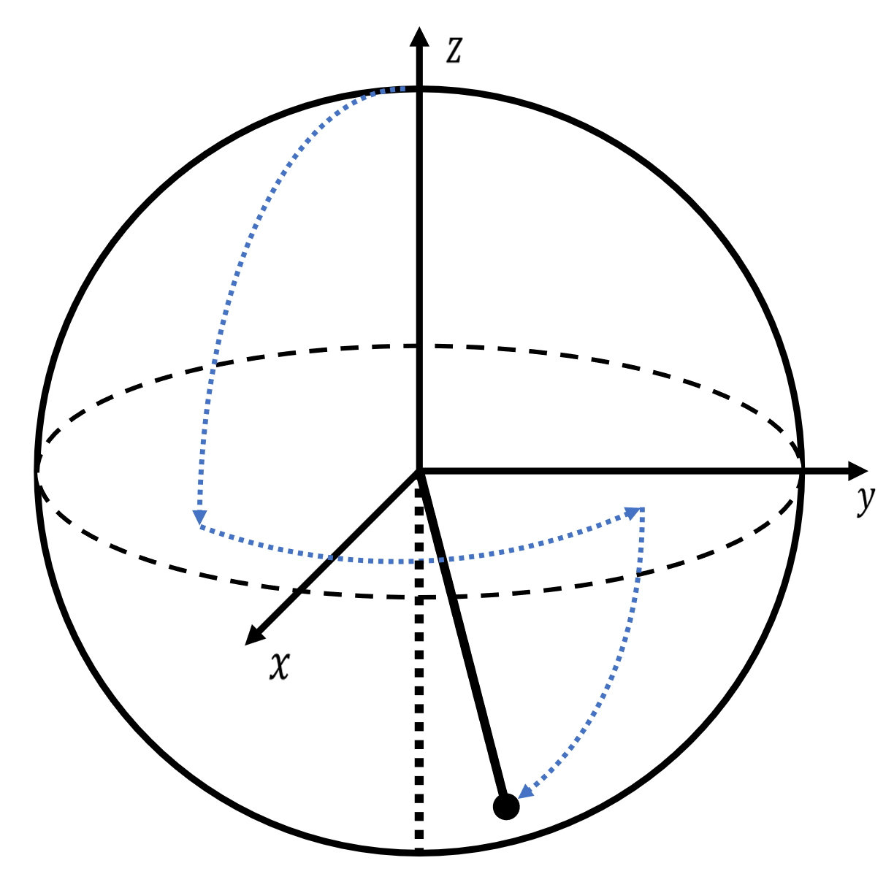
Quantum compiling
Continuous
state space
Discrete operations
How to perform an arbitrary unitary operation with a discrete gate set?
?

Slide 6
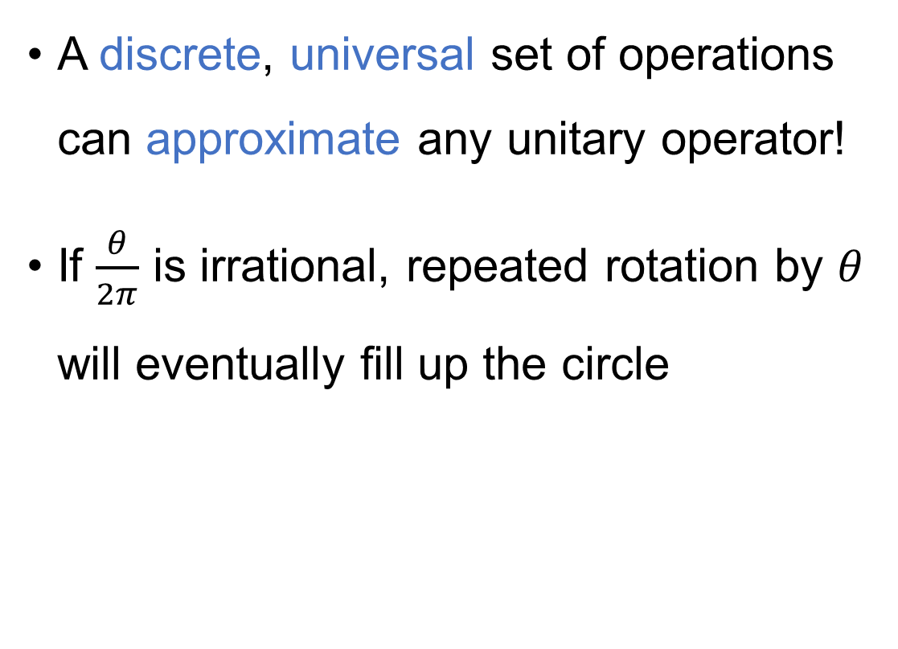

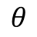
Quantum compiling
A discrete, universal set of operations can approximate any unitary operator!
If $\frac{θ}{2π}$ is irrational, repeated rotation by $θ$ will eventually fill up the circle
$$⋯⋯$$
$$θ$$

Slide 7
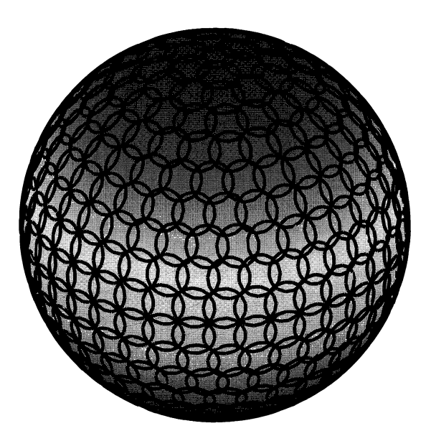
Quantum compiling
Two different rotations will fill up the bloch sphere

Slide 8
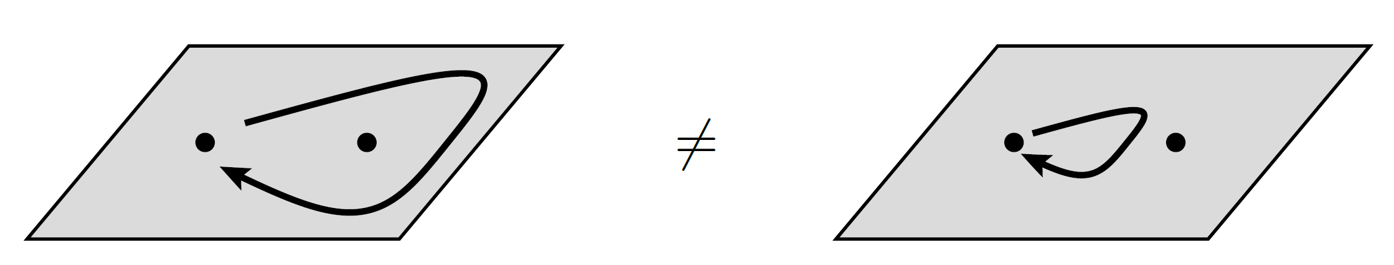
Example: Topological quantum computing
Compute by braiding anyons
When exchanging two anyons, we obtain a nontrivial phase factor:
$$\left|ψ_{1}ψ_{2}\right\rangle =e^{iθ}\left|ψ_{2}ψ_{1}\right\rangle$$

Slide 9
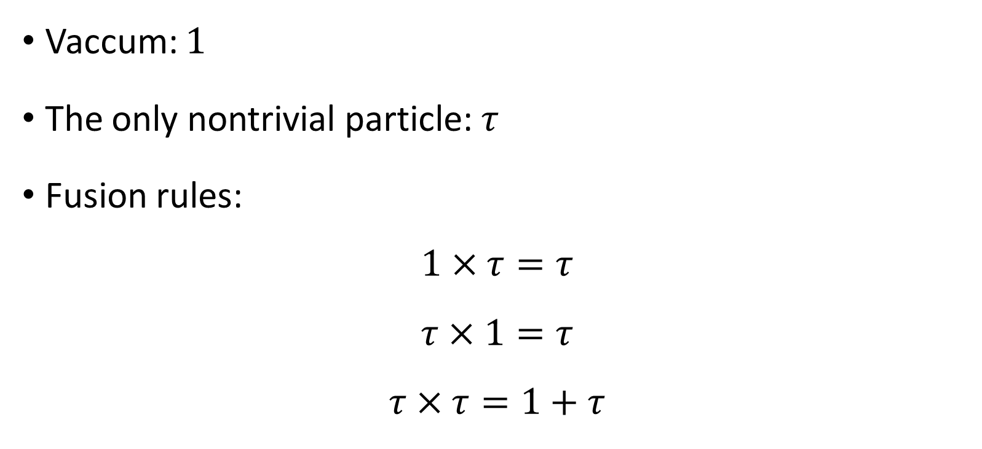
Fibonacci anyons
Vaccum: $1$
The only nontrivial particle: $τ$
Fusion rules:
$$1×τ=τ$$
$$τ×1=τ$$
$$τ×τ=1+τ$$

Slide 10
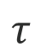
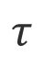
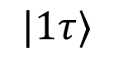
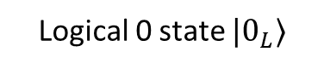
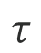

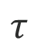
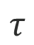


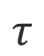
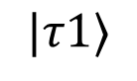

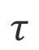
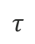

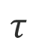
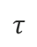
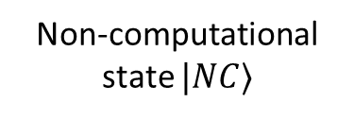
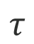
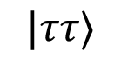
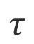
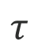
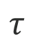
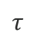
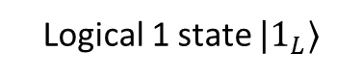
Fusion tree basis
$$1$$
$$τ$$
$$τ$$
$$τ$$
$$τ$$
$$1$$
$$τ$$
$$τ$$
$$τ$$
$$τ$$
$$τ$$
$$τ$$
$$τ$$
$$τ$$
$$τ$$
$$1$$
$$τ$$
$$τ$$
$$τ$$
$$τ$$
$$1$$
$$|1τ⟩$$
$$|ττ⟩$$
$$|τ1⟩$$
Logical 0 state $|0_{L}⟩$
Logical 1 state $|1_{L}⟩$
Non-computational state $|NC⟩$

Slide 11
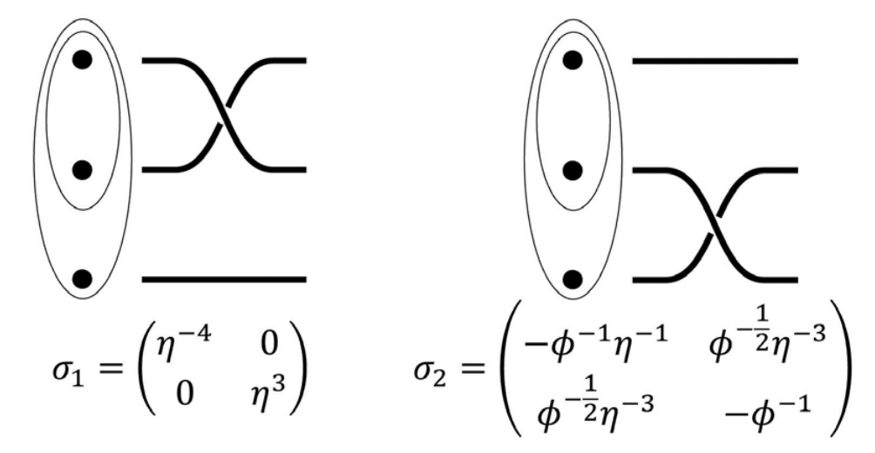
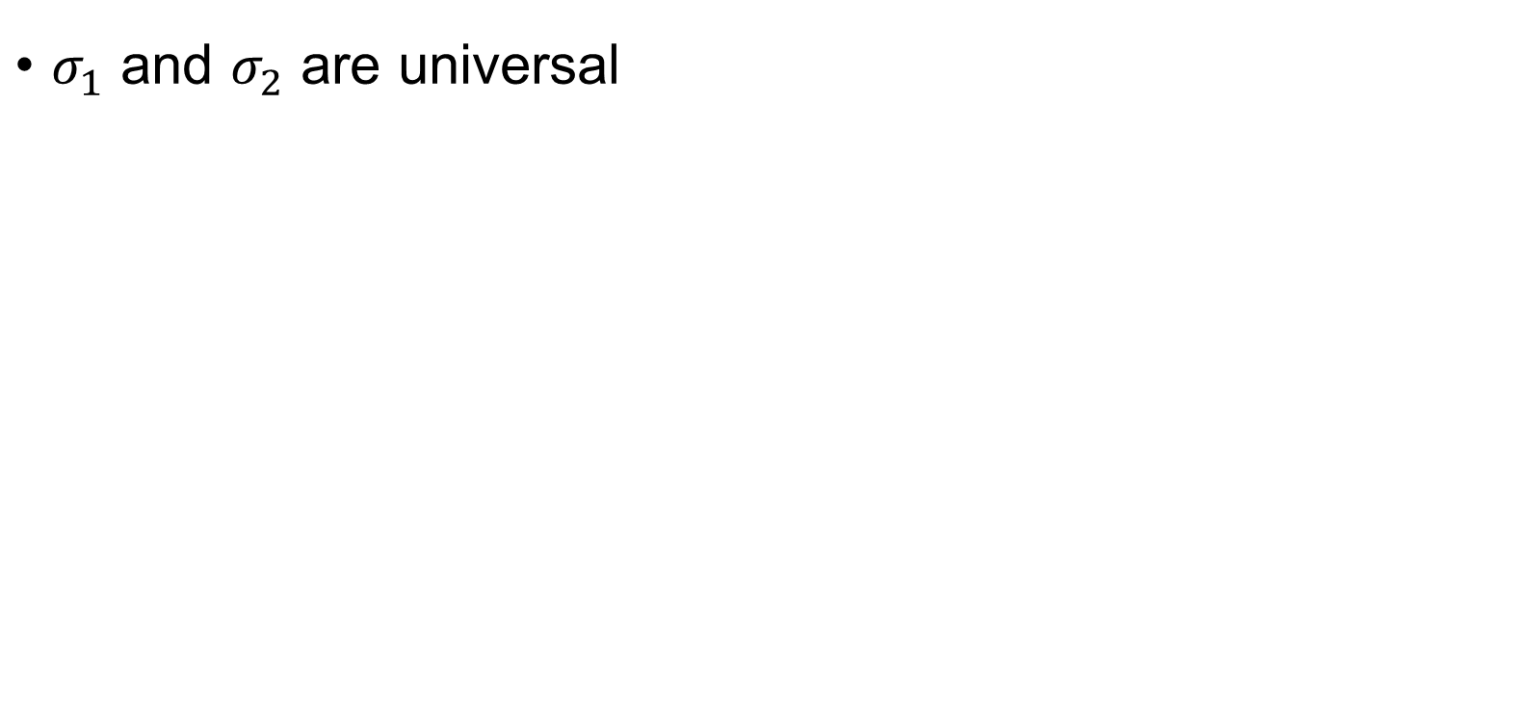
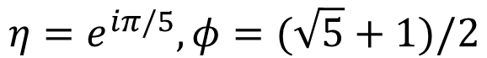
Elementary braiding matrices
$σ_{1}$ and $σ_{2}$ are universal
$$η=e^{iπ/5}, φ=(\sqrt{5}+1)/2$$

Slide 12
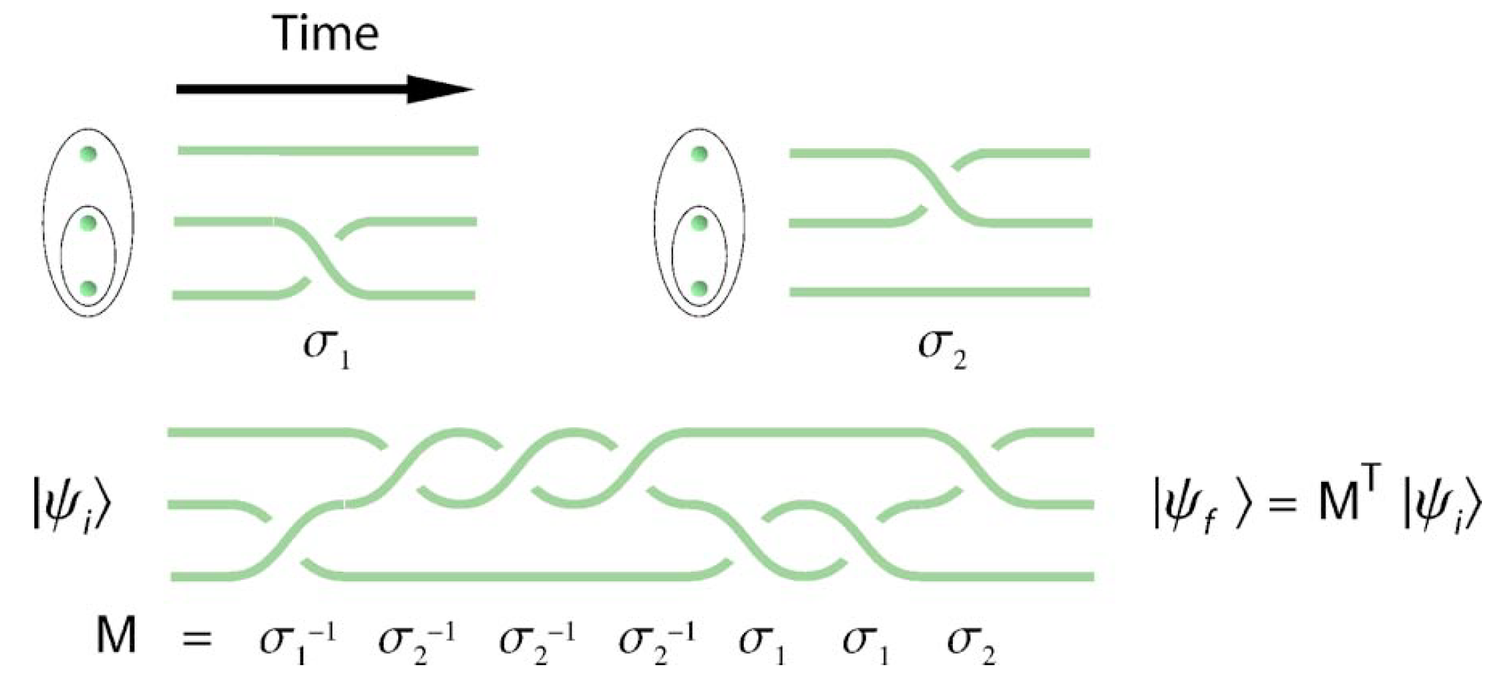
Topological quantum compiling
How to find the braiding sequence for some specific gate?
Hormozi, Layla, et al. "Topological quantum compiling." Physical Review B 75.16 (2007): 165310.

Slide 13
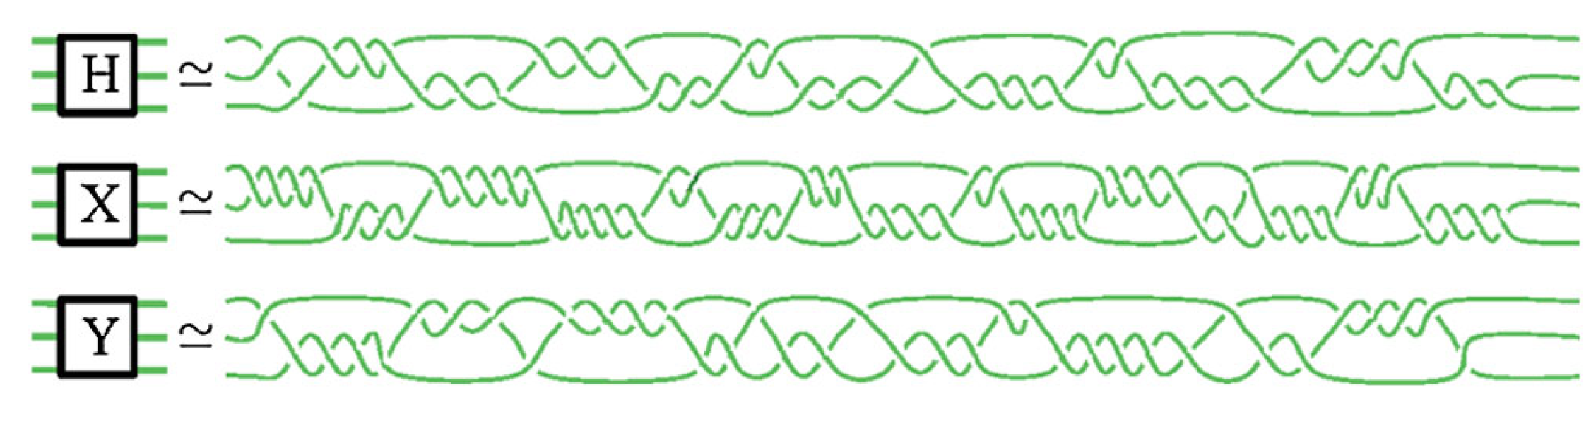
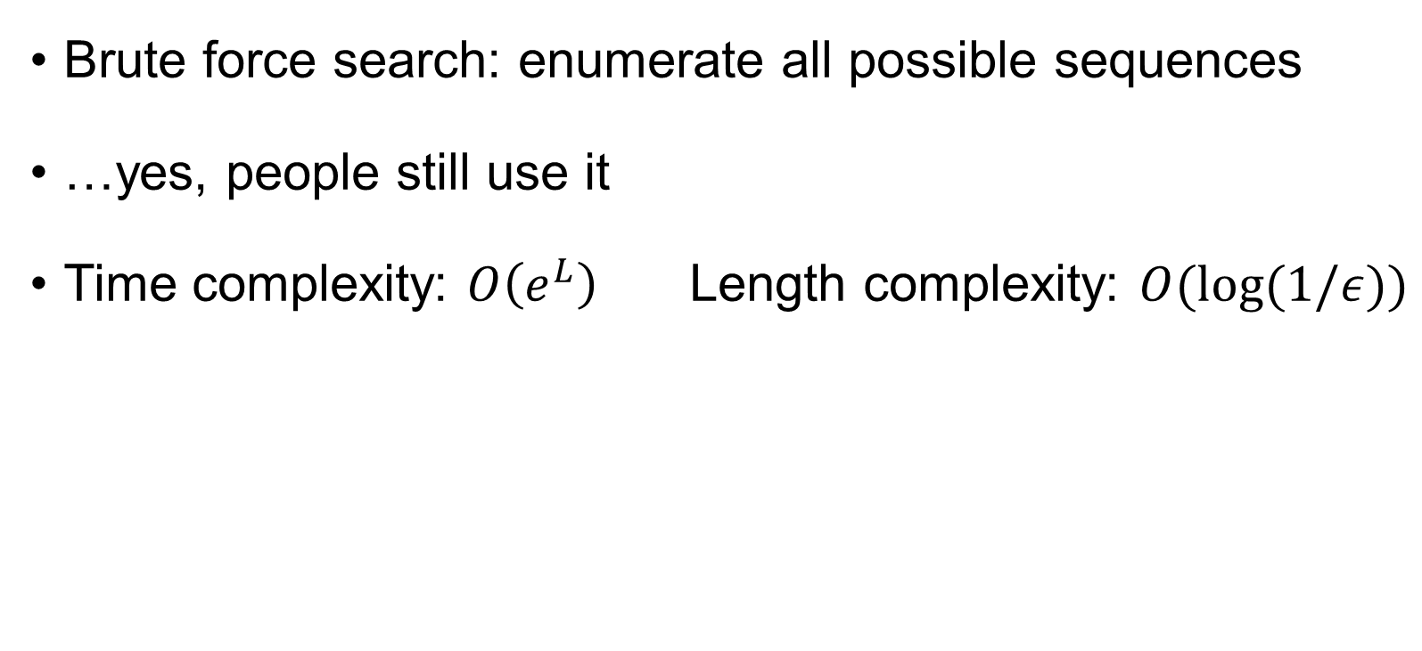
Topological quantum compiling
Brute force search: enumerate all possible sequences
…yes, people still use it
Time complexity: $O\left(e^{L}\right)$Length complexity: $O(log(1/ε))$
Deng, Dong-Ling, et al. "Fault-Tolerant Greenberger-Horne-Zeilinger Paradox Based on Non-Abelian Anyons." Physical review letters 105.6 (2010): 060402.

Slide 14
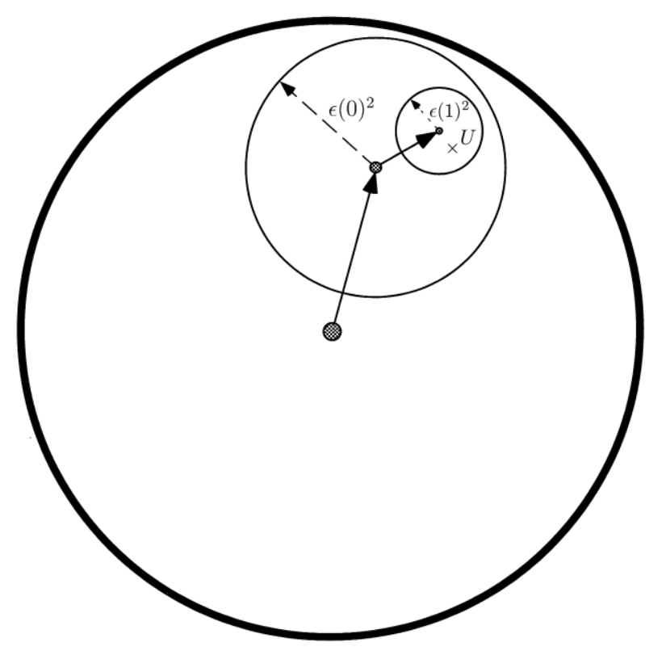
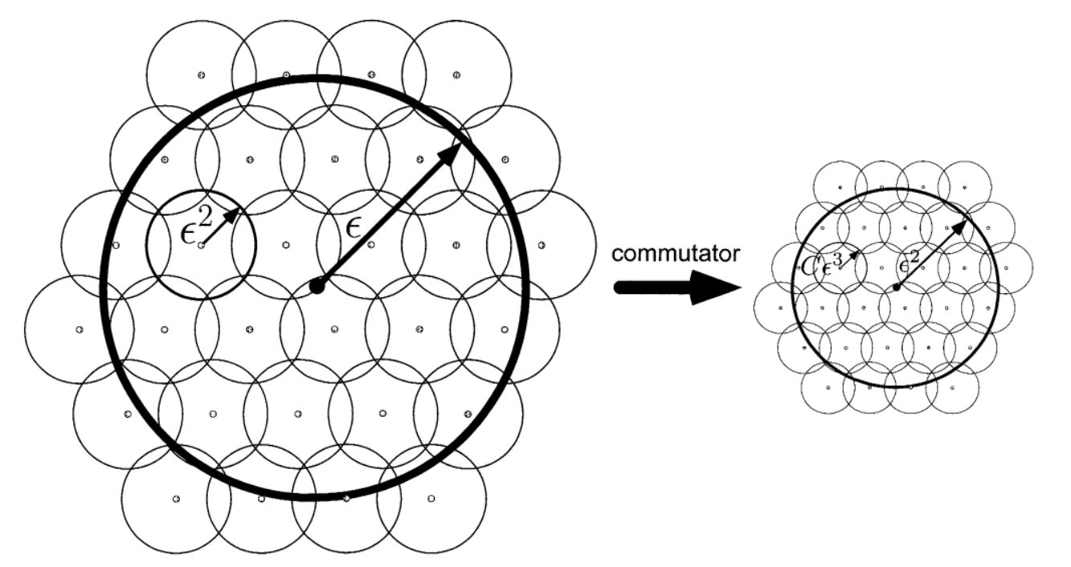
Topological quantum compiling
Solovay-Kitaev algorithm
Cover the space with finer and finer grids using commutators
Nielsen, M. A., & Chuang, I. (2002). Quantum computation and quantum information.

Slide 15
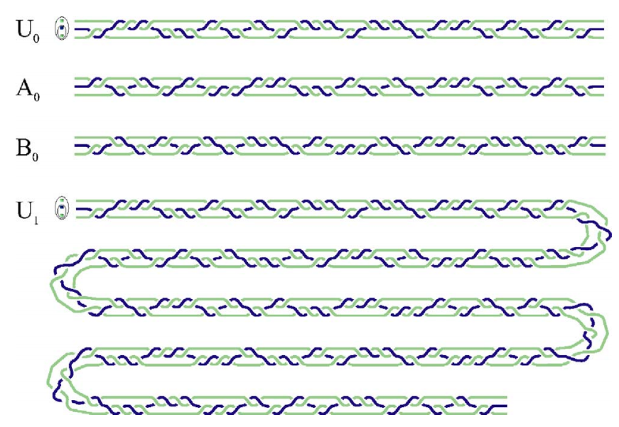
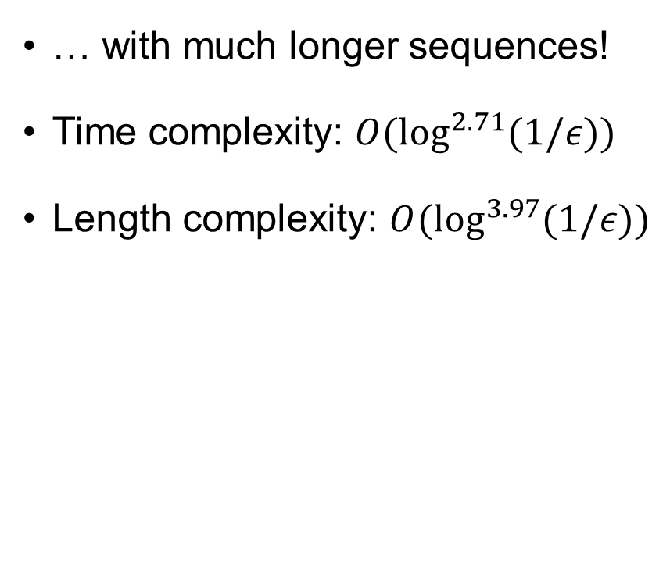
Topological quantum compiling
… with much longer sequences!
Time complexity: $O(\log^{2.71}{(1/ε)})$
Length complexity: $O(\log^{3.97}{(1/ε)})$
Dawson, Christopher M., and Michael A. Nielsen. "The solovay-kitaev algorithm." arXiv preprint quant-ph/0505030 (2005).
Hormozi, Layla, et al. "Topological quantum compiling." Physical Review B 75.16 (2007): 165310.

Slide 16
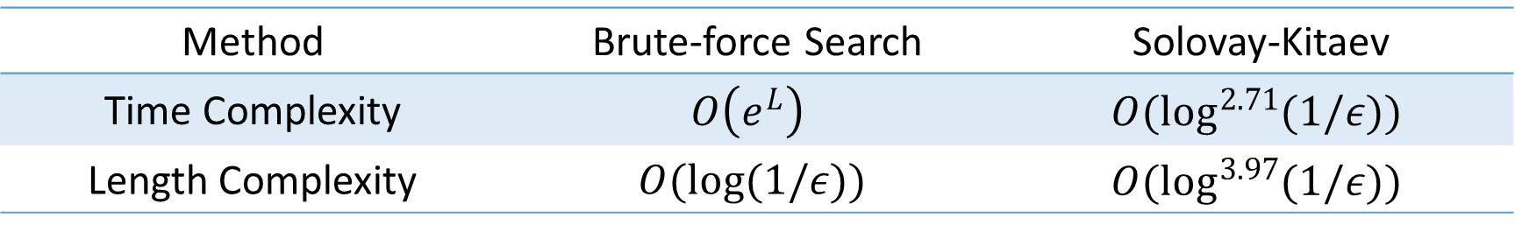
Topological quantum compiling
Method | Brute-force Search | Solovay-Kitaev
Time Complexity | $$O\left(e^{L}\right)$$ | $$O(\log^{2.71}{(1/ε)})$$
Length Complexity | $$O(log(1/ε))$$ | $$O(\log^{3.97}{(1/ε)})$$
Can we do better?

Slide 17

Reinforcement Learning

Slide 18
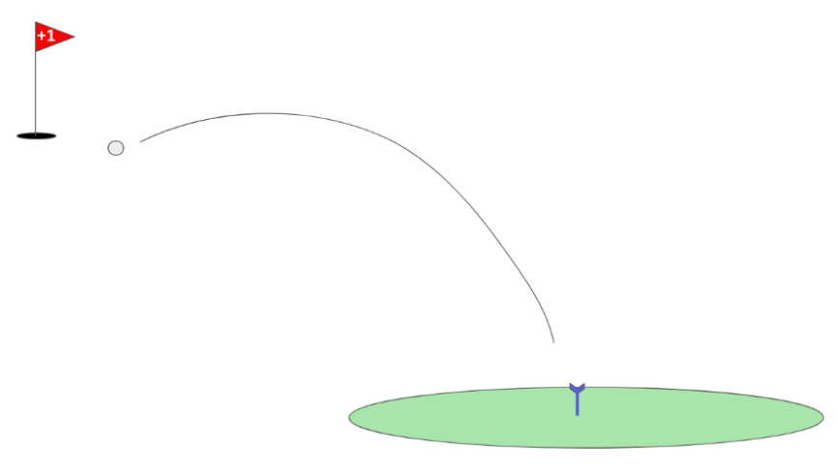
Example: Playing Golf
Reward=1 if the ball reaches the target
Reward=0 otherwise
Agent is almost impossible to learn anything in this scenario
https://medium.com/analytics-vidhya/advanced-exploration-hindsight-experience-replay-fd604be0fc4a

Slide 19
Example: Playing Golf
One solution: reward the agent based on the distance to the target
https://medium.com/analytics-vidhya/advanced-exploration-hindsight-experience-replay-fd604be0fc4a

Slide 20
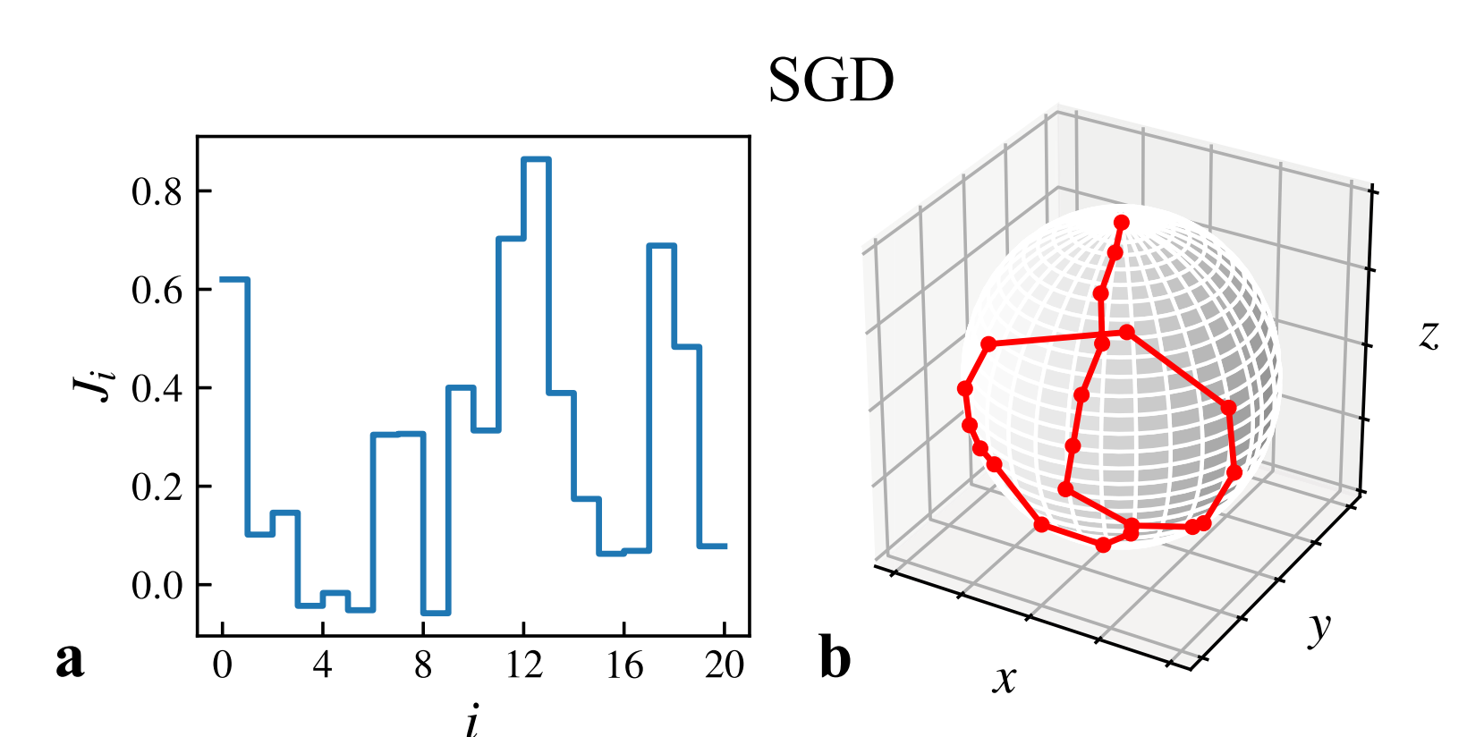
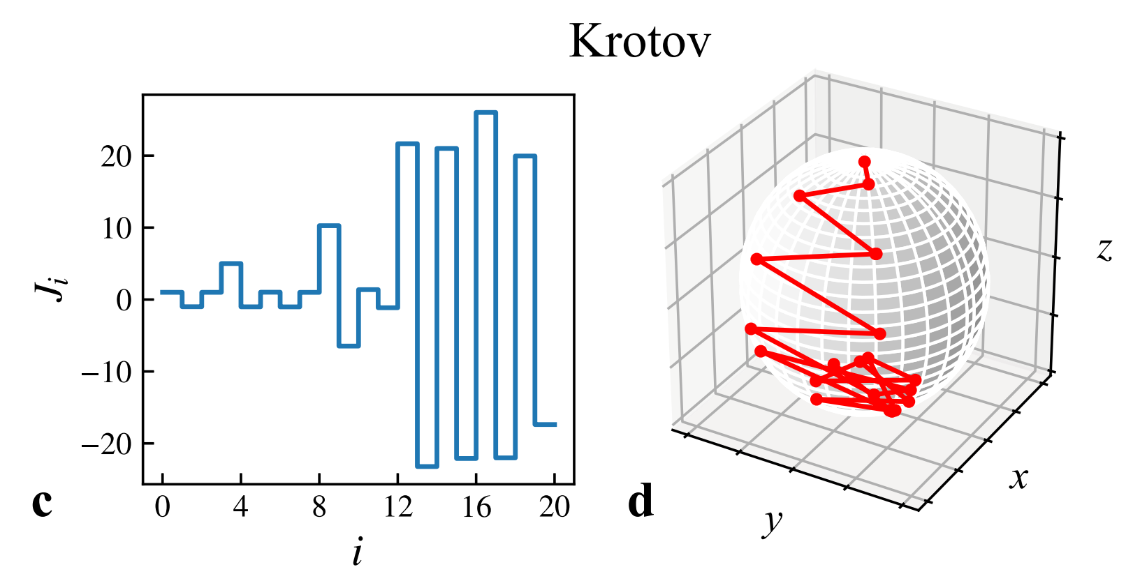
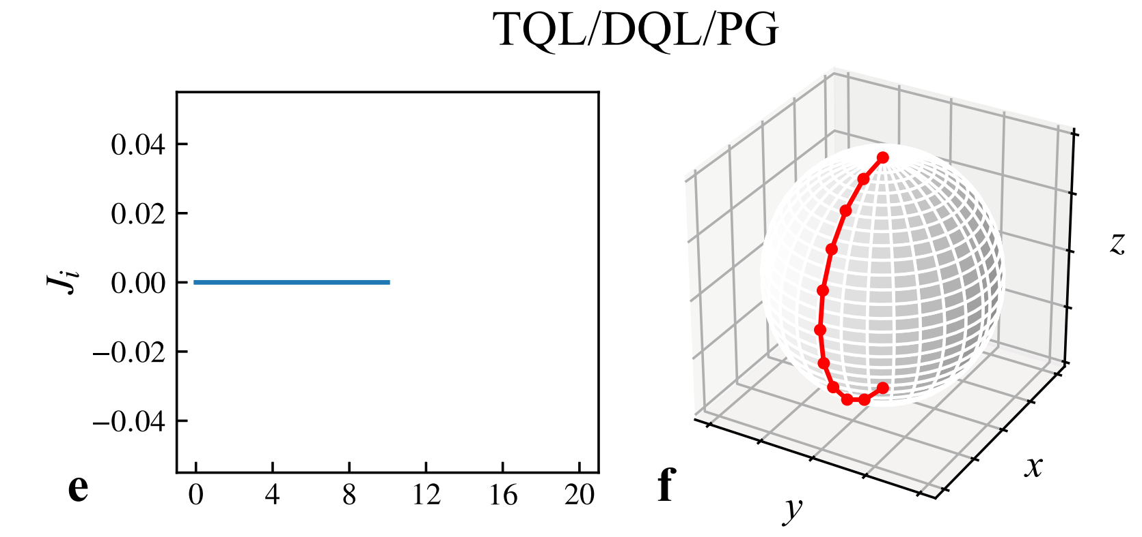
Example: Quantum control
Zhang, Xiao-Ming, et al. "When does reinforcement learning stand out in quantum control? A comparative study on state preparation." npj Quantum Information 5.1 (2019): 1-7.

Slide 21
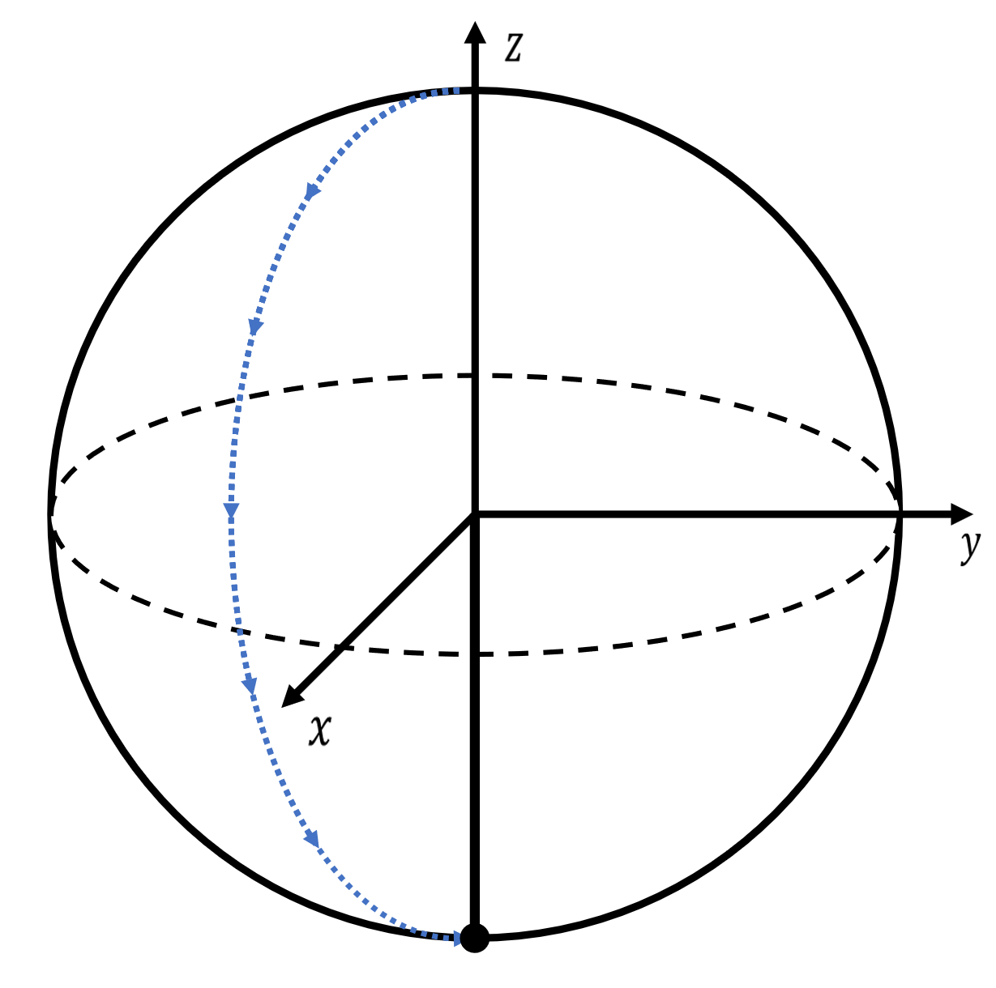
Topological Quantum Compiling
What if distance as reward function fails?
Easy for reinforcement learning
Hard for reinforcement learning

Slide 22
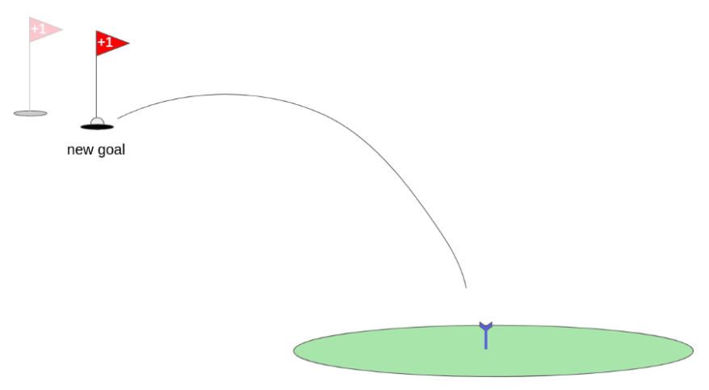
Example: Playing Golf
A solution: Hindsight experience replay
Andrychowicz, Marcin, et al. "Hindsight experience replay." arXiv preprint arXiv:1707.01495 (2017).
https://medium.com/analytics-vidhya/advanced-exploration-hindsight-experience-replay-fd604be0fc4a

Slide 23
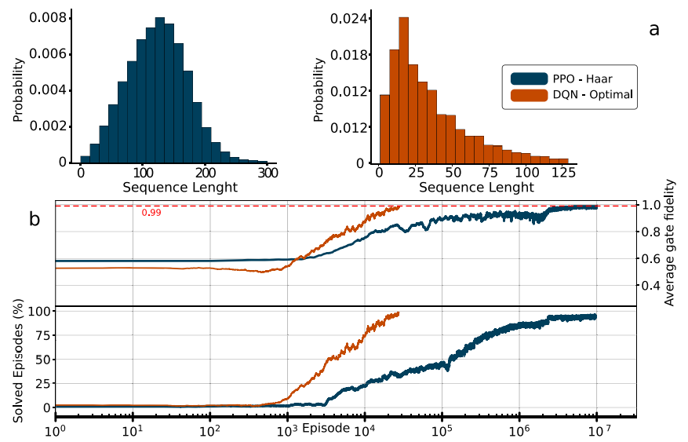
Quantum Compiling with RL
Moro, L., Paris, M.G.A., Restelli, M. et al. Quantum compiling by deep reinforcement learning. Commun Phys 4, 178 (2021).

Slide 24
Quantum Compiling with RL
Another solution: learn a suitable distance metric
Inspiration: Rubik’s cube

Slide 25
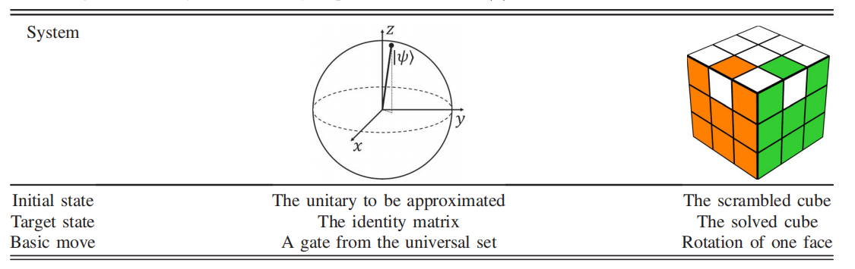
Quantum Compiling with RL
Zhang, Yuan-Hang, et al. "Topological Quantum Compiling with Reinforcement Learning." Physical review letters 125.17 (2020): 170501.

Slide 26
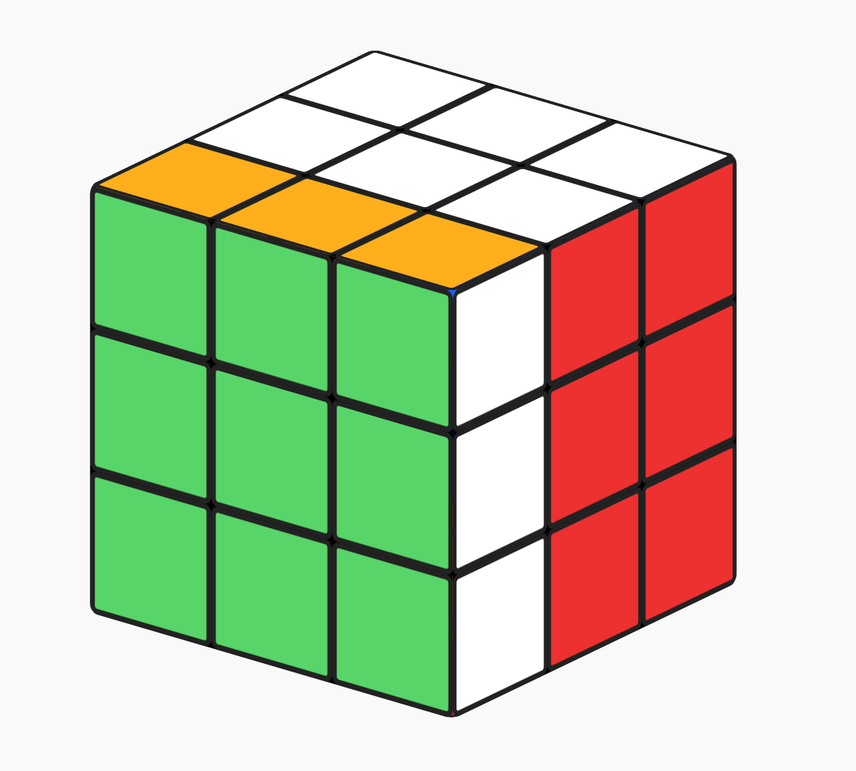
Distance: 1

Slide 27
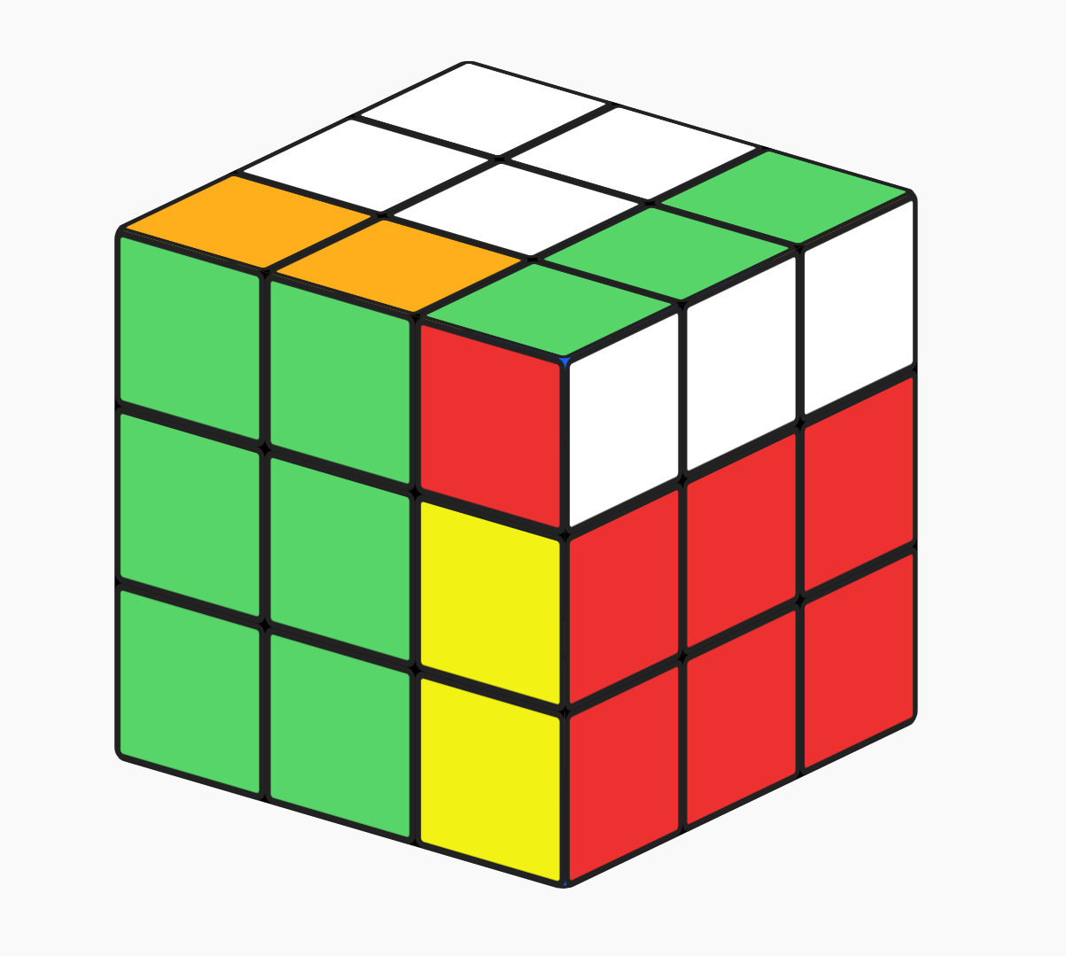
Distance: 2

Slide 28







$$J′\left(s_{0}\right)=$$
$$\min\left(5, 7\right)+1=6$$
To train the neural network to remember the distance function $J\left(s\right)$, the neural network updates on itself:
$J′\left(s\right)=\min_{s^{′}}\left(J\left(s^{′}\right)\right)+(cost of one move)$
$$J\left(s_{1}\right)=7$$
$$J\left(s_{2}\right)=5$$

Slide 29




Quantum Compiling with RL
$$J\left(s\right)=0$$
$$J\left(s\right)=1$$
$$J\left(s\right)=2$$
$$J\left(s\right)=3$$

Slide 30




Quantum Compiling with RL
An improvement on top of greedy algorithm: A* search
$$f\left(s\right)=λG\left(s\right)+J(s)$$
Distance already traveled
(estimated) distance left
$λ=1$ optimal path
$λ=$0.5 suboptimal path
https://en.wikipedia.org/wiki/A*_search_algorithm

Slide 31






Quantum Compiling with RL
Decimal penalty term: eliminate incorrect interpolations
$$d\left(s\right)=γ\frac{{\left\{J\left(s\right)−round\left[J\left(s\right)\right]\right\}}^{2}}{J(s)}$$
$$J\left(s\right)=0$$
$$J\left(s\right)=1$$
$$J\left(s\right)=2$$
$$J\left(s\right)=1.5 ?$$
$$J\left(s\right)=3$$

Slide 32

Quantum Compiling with RL
Zhang, Yuan-Hang, et al. "Topological Quantum Compiling with Reinforcement Learning." Physical review letters 125.17 (2020): 170501.

Slide 33


Quantum Compiling with RL
Time complexity:$O(log(1/ε))$ (when$ε$ is not too small)
Length complexity: $O\left(\log^{α}\left(\frac{1}{ε}\right)\right), α\sim 1.6$
Zhang, Yuan-Hang, et al. "Topological Quantum Compiling with Reinforcement Learning." Physical review letters 125.17 (2020): 170501.

Slide 34

Quantum Compiling with RL
Zhang, Yuan-Hang, et al. "Topological Quantum Compiling with Reinforcement Learning." Physical review letters 125.17 (2020): 170501.

Slide 35

Summary
Method | Brute-force Search | Solovay-Kitaev | Reinforcement Learning
Time Complexity | $$O\left(e^{L}\right)$$ | $$O(\log^{2.71}{(1/ε)})$$ | $$O(log(1/ε))$$
Length Complexity | $$O(log(1/ε))$$ | $$O(\log^{3.97}{(1/ε)})$$ | Slightly worse than Brute-force search
Maximum Accuracy | $$\sim {10}^{−3}$$ | No upper bound | $$\sim {10}^{−3}$$

Slide 36

Summary
Reinforcement learning, $U≈G_{n}G_{n−1}⋯G_{3}G_{2}G_{1}$
Near-optimal
No ancilla
No restriction on gate set, generally applicable to various systems
Easily adapt to gates with different costs
Limited to small systems
Combine with other algorithms for larger systems

Slide 37
Thank you!
Yuanhang Zhang

